Slide 1
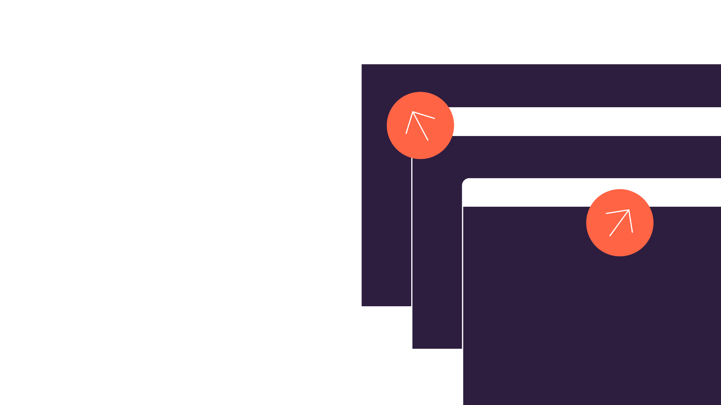
CTO Board Slides

Slide 2
How to use this deck
Hey there, thanks for downloading my deck!
Reporting on engineering performance to the board can be daunting, so I wanted to share how I translate metrics into business outcomes.
I’ve tried to create some standard slide templates you can use, while also providing example data that works well for both executive and board reporting.
So feel free to pick and choose, make sure you’re covering what you are working on, and try to show trends and goals for the next quarter.
Good luck!

Slide 3
Q2 UPDATE
Key Investments
Q2 Projects
Q3 Focus Areas
Project | Q1 Cost | Headcount | Status
ABC-123 Client Reporting | $415K | 8.3 | GA ⏺
ABC-244 Platform Scale | $397K | 10.8 ↑ | On Track ⏺
ABC-244 Integrations Suite | $381K | 7.2 ↓ | At Risk ⏺
ABC-244 Platform Infra | $294K | 5.5 | On Track ⏺
ABC-244 Platform Scale | $526K | 14.1↑↑ | Beta ⏺
Project | Inv. Type | Description
CDF-456 | New | Client Onboarding Platform
ARG-991 | DevEx | Employee Performance Dashboard
PRJ-15 | KTLO | Project Management Suite
ICD-660 | New | Customer Support Automation Tool
UIS-331 | New | Document Collaboration Platform

Slide 4
Q2 UPDATE
Executive Summary
R&D is making strong progress toward our strategic goals, particularly in cloud migration, product innovation, and cybersecurity, while staying focused on managing risks related to AI and regulatory changes.
Strategic Priorities in Q3
Continue progress on the cloud migration, with the goal of 100% transition by the end of Q4.
Finalize and scale the AI product features across our core platforms.
Enhance our data analytics capabilities to support better decision-making across the business.
Team Updates & Open Roles
Headcount flat at 124, with Q3 target of 130
5 open roles, w/ a Sr. group manager search under way
Key Initiatives & Progress
In Q2 we launched new AI-powered features that have received positive feedback from customers, with early adopters reporting a 15% increase in efficiency and a 9% improvement in customer satisfaction scores.
Additionally we’ve made significant improvements to our developer experience, streamlining workflows and reducing friction, leading to a 20% increase in team productivity and a 24% reduction in development time for key features.

Slide 5
FEATURED METRICS
Q2 UPDATE
Engineering Health
Cycle Time
2d 10h ↓
Introduced automations to yield 20% reduction QoQ
Planning Accuracy
71% ↑
Rolled out org. wide goal initiative focused on sprint planning
Project Delivery: Successfully launched 3 major features on time, with 95% of projects meeting deadlines and quality standards.
Team Performance: Engineering team productivity has increased by 20% due to recent process improvements and targeted training initiatives.
Technical Debt: Reduced technical debt by 15% through focused refactoring efforts, ensuring long-term system scalability and maintainability.
Change Failure
.4% ↓
Continuing elite quality trend from new testing suite
Automation
16k hours saved
The impact of operationalizing new AI workflow automations
Notes:
Benchmarks for these metrics are based on the 2025 Software Engineering Benchmarks Report: https://linearb.io/resources/software-engineering-benchmarks-report

Slide 6
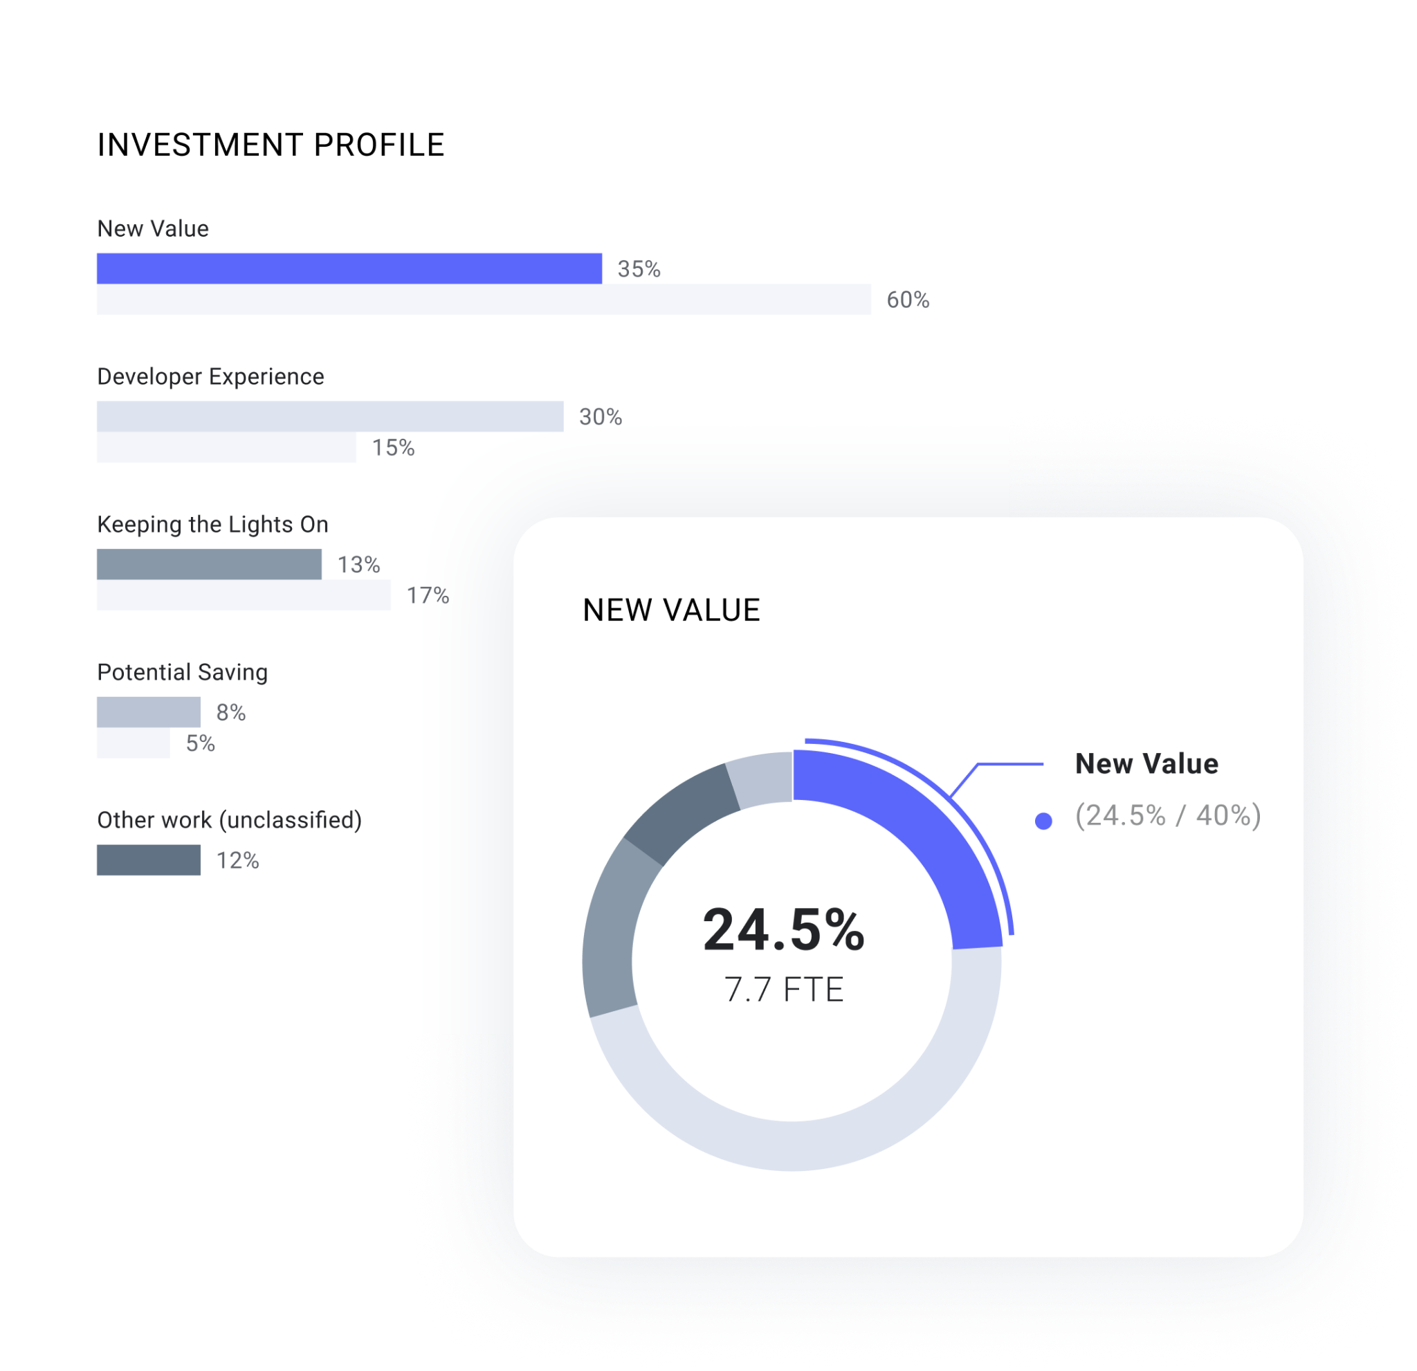
Q2 UPDATE
Investment Profile
Strategy Overview
Over the past quarter we’ve made shifted project focus areas in order align more closely to our aligned investment benchmarks.
New Value: 7% QoQ jump in Q2 as we continue to adjust headcount to platform scale projects.
Feature Enhancements: 12% decrease QoQ with a heavier investment planned via Q3 focus areas
Developer Experience: 4% QoQ growth due to investment in new tooling integrations across teams
Keeping the Lights On: Continues to rise as anticipated due to quality issues in data services and cloud migration.

Slide 7
Org. Initiatives
GenAI Adoption
Code Quality
Experience & Productivity

Slide 8
Q2 ENGINEERING INITIATIVES
GenAI Adoption
In Q2 we continued to roll out GenAI coding tools in the IDE and AI-based code reviews, with substantial upside. We are experimenting with Coding Agents, documentation and quality use cases, expecting to operationalize in Q4.
Code Assist Operational ⏺ |  | Code Review Operational ⏺ |  | Coding Agents Experimental ⏺
ADOPTION 68% of devs | Q1: 45% Q3 goal: 75% | ADOPTION 44% of pull requests | Q1: 35% Q3 goal: 60% | ADOPTION 4 teams | Q3 goal: 12 teams 9% of PRs
IMPACT 12% decrease in coding time |  | IMPACT 6.9K dev hours saved in Q2 |  | IMPACT 7% of pull requests now AI created
Notes:
Active investment in the machine itself to makes sure it’s ready for the challenges and requirements of the business itself. Maybe speak about hiring.

Slide 9
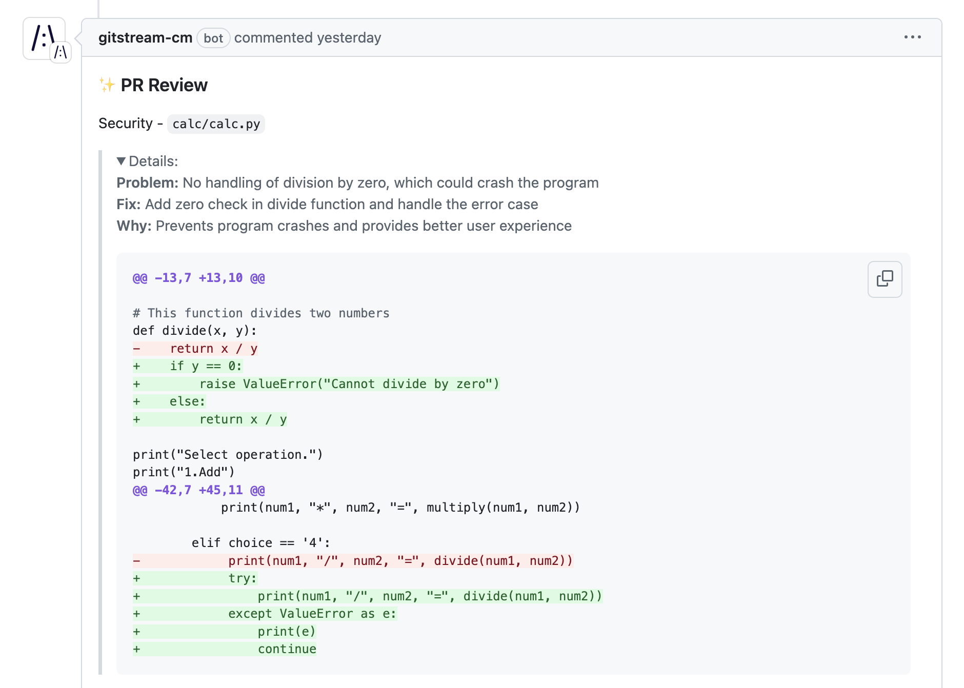
INITIATIVE SUMMARY
GenAI Under the Hood
Over the past quarter, we’ve explored and implemented AI-driven capabilities in areas such as code generation, code review support automation, and predictive analytics.
Code Assist | We have implemented GitHub Copilot in order to decrease coding time and bug rates. To date we’ve seen 78% positive rating from our devs.
Code Review | AI Workflows continue to expand beyond the IDE with the use of gitStream to take first review on all PRs. Early impact shows 6k dev hours saved.
Coding Agents | We have started live experiments with GPT-4o, taking on small tasks with heavy governance surrounding them.
GenAI Code Review
Notes:
Active investment in the machine itself to makes sure it’s ready for the challenges and requirements of the business itself. Maybe speak about hiring.

Slide 10
Q2 ENGINEERING INITIATIVES
Developer Productivity & Experience
In Q2, we focused on enhancing developer experience and productivity by rolling out new automation tools within our git and chat tools that are showing promising improvements in time to market and hours saved.
Automation |  | Efficiency |  | DevEx
16K Dev hours saved |  | 3d19h ↓ Time to Market Top Quartile Performance |  | 54 Engineering NPS | Q1: 51% Q3 goal: 60%
5% Of pull requests auto-merged | Q1: 2% Q3 goal: 9% | 71% ↑ Planning Accuracy | Q1: 70% Q3 goal: 75% | 1.8 ↑ Merge Frequency | per dev/wk
Notes:
Active investment in the machine itself to makes sure it’s ready for the challenges and requirements of the business itself. Maybe speak about hiring.

Slide 11
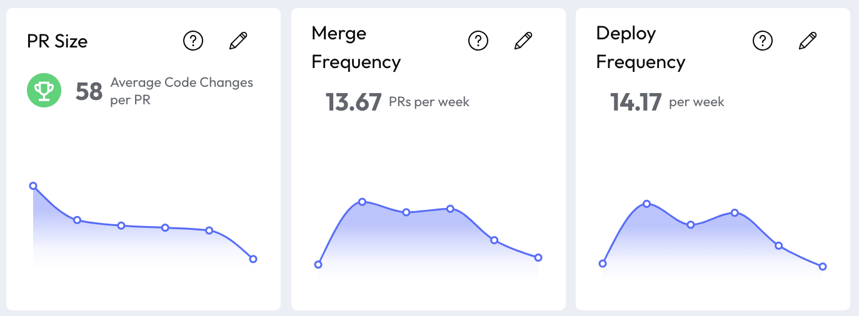
INITIATIVE SUMMARY
DevEx Under the Hood
Over the past quarter, we’ve enhance our data analytics capabilities and developer automations to support better decision-making across the business and decrease toil.
Auto-Merge | Our latest tool, gitStream, has allowed us to auto-merge safe changes, due to new governance and policy capabilities.
Planning Accuracy | The entire eng. org. has taken goals to improve the way we plan and work through sprints. Early survey results show a 11% increase in positive ratings for our ways of working.
engNPS | We continue to make positive improvement on our engNPS scores, which are directly correlated with our improving employee retention numbers.
Team Productivity View
Notes:
Active investment in the machine itself to makes sure it’s ready for the challenges and requirements of the business itself. Maybe speak about hiring.

Slide 12
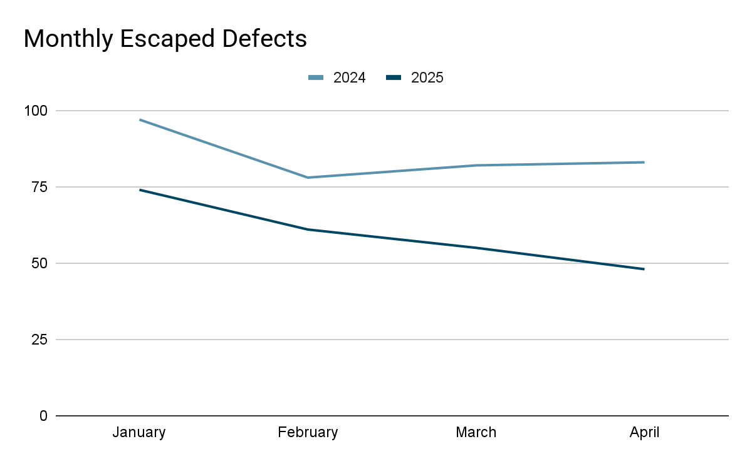
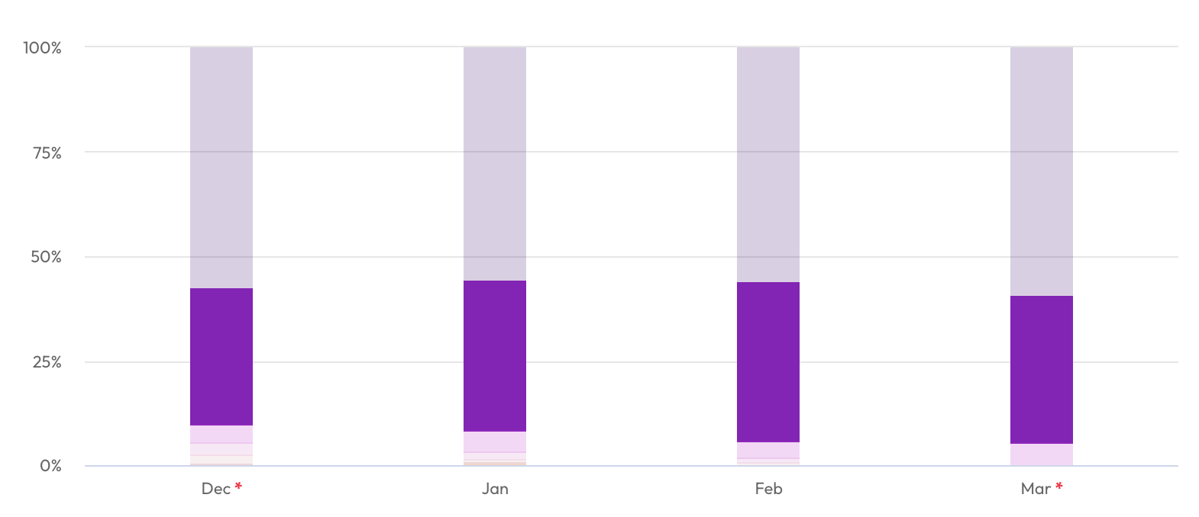
Q2 ENGINEERING INITIATIVES
Quality
Q2 Investments
Increase code coverage to 80%
Fix flaky tests in 40% of suites
New e2e testing harness
Impact
12% drop in escaped defects QoQ
20% reduction in failed tests
Effort allocation for customer issues down 7% QoQ
Q3 Focus
Coverage to 85%
Form dedicated QA team
→ Resource Allocation: Customer Issues

